Slide 1
Computer on FPGA
Faculty Guide: Shubhajit Roy Chowdhury
Students: Jashwanth Reddy
Kurra Lokesh

Slide 2
What is FPGA??
It’s a Programmable Logic Device.
Contains logic blocks and interconnects.
These blocks contain memory , logic ,math functions etc…..
I/O blocks
SRAM cells pathway decide functionality i.e., LUT
EEPROM cells – Non-volatile but programmable

Slide 3
VHDL FPGA
Model for hardware device
Design
Entity & Signals
Architecture
Configuration
Programming language
Procedures
Functions

Slide 4
Simple VHDL Program
library ieee; Use ieee.std_logic_1164.all; entity counter is port( clk: in std_logic; reset: in std_logic; enable: in std_logic; count: out std_logic_vector (3 downto 0)); end counter; architecture behav of counter is signal pre_count: std logic_vector (3 downto 0); begin process( clk , enable, reset) begin if reset = '1' then pre_count <= "0000"; | Elsif (clk='1' and clk'event) then if enable = '1' then pre_count <= pre_count + "1"; end if; end if; end process; count <= pre_count; end behav;

Slide 5
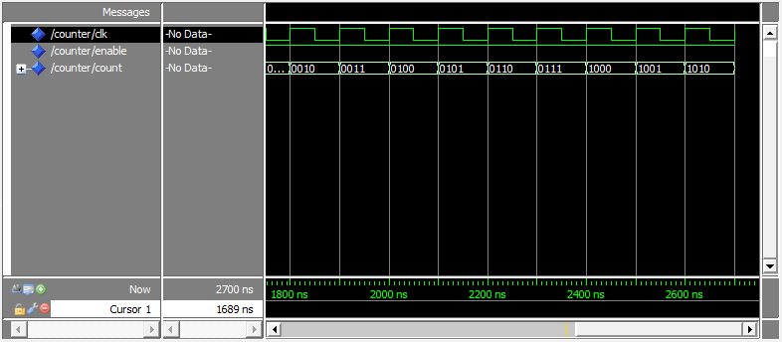
Simulation Results

Slide 6
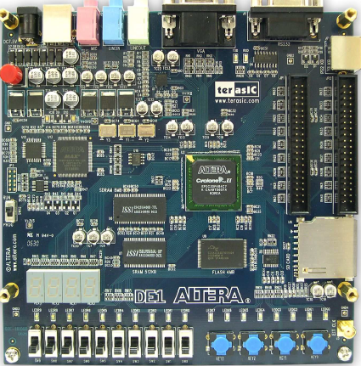
FPGA
DE1 board
State of art Cyclone II 2C20.
For simple Digital Logic experiments it contains slides , switches, LED’s etc…

Slide 7
Supporting softwares
Quartus II web Edition
Nios II Software Build Tools
SOPC builder
Nios II Embedded Design Suite
Modelsim Altera Starter Edition 6.5b

Slide 8
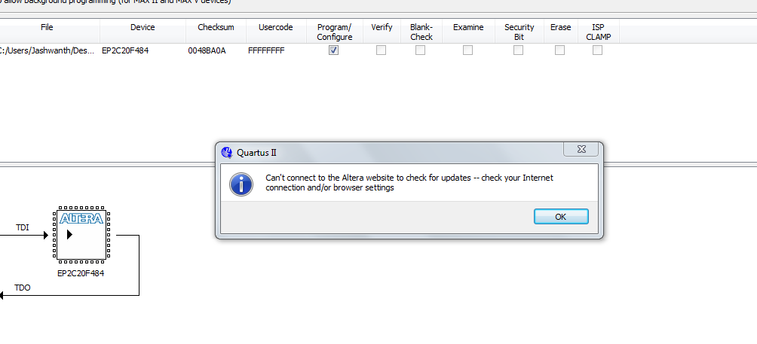
Problem!!!

Slide 9
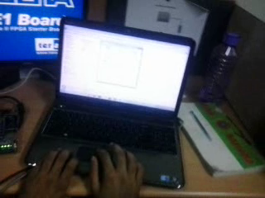
Small Demo

Slide 10
Experiments
Audio Signals
24bit CODEC
Video Signal
VGA Connector
PS2 connector was not available for connectivity.
However we tested VGA connector

Slide 11
How to run on FPGA
First we created a new project.
We added required vhdl files to the project.
Compile Design consists of
Analysis & Synthesis
I/O Assignment Analysis
Place and Route
Assembler
TimeQuest Analysis

Slide 12
How to Dump on FPGA
After compiling vhdl code go to Assignment->pin planner and give required pins on FPGA. Perform I/O Analysis and open tools->programmer-> and finally configure .sof file and dump into FPGA.

Slide 13
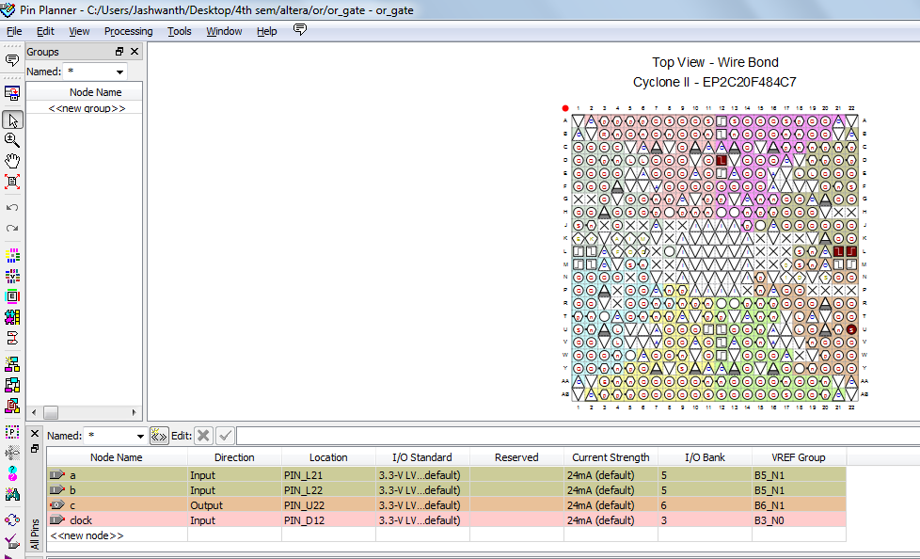

Slide 14
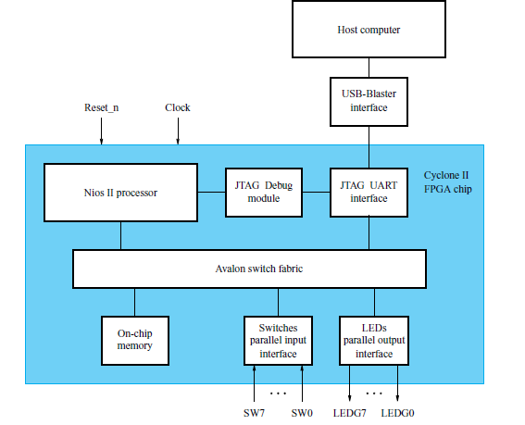
Basic Module

Slide 15
NIOS-II processor
Soft processor that can be instantiated on Altera FPGA device.
Provide timers , communication interfaces , i/o interfaces , memories etc…
Follows RISC Architecture.

Slide 16

One can spend life time to learn these FPGA architectures and their development.

Slide 17
THANK YOU

